Slide 1
Real Estate Management System
Minor project

Slide 2
INTRODUCTION
Real Estate (property) Management system is developed for those who are searching property according to their criteria or nearby location. Seller can post their property on the website with complete details about property and contact information. Buyers visit this website, look property and if they like any property they can contact seller through the given number or email ID.

Slide 3
OBJECTIVES
The system is user friendly.
Minimize the manual work and maximize the productivity.
Aims to provide a system which can store records systematically
Shows the information and description of the properties available.
Updating ,Adding of records is improved which result in proper resource management of properties data

Slide 4
SYSTEM ANALYSIS
This section will contain the DFD , ER

Slide 5
DATA FLOW DIAGRAM (DFD)
Context diagram, 1st level for Admin, 1st level for user

Slide 6
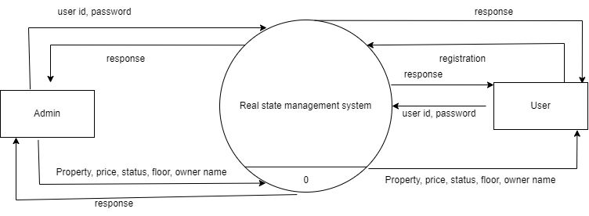
CONTEXT DIAGRAM

Slide 7
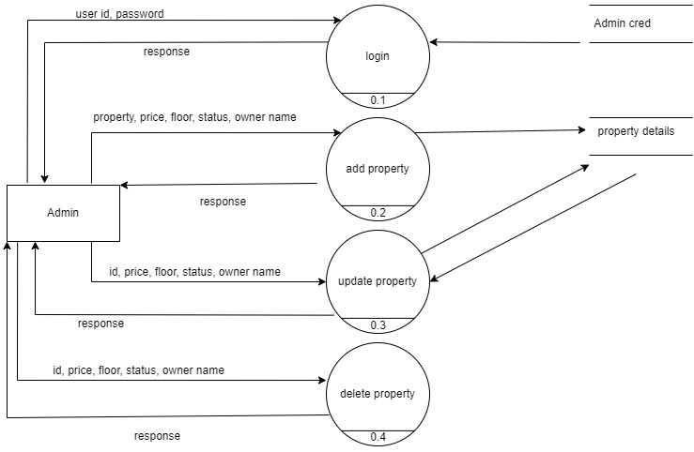
DFD LEVEL 1 FOR ADMIN

Slide 8
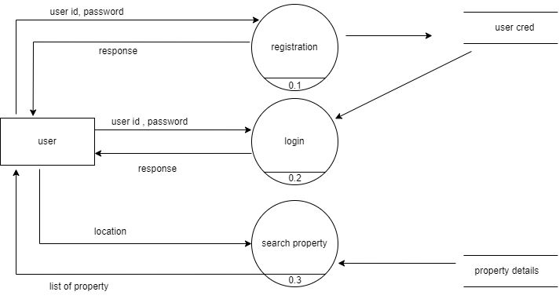
DFD LEVEL 1 FOR USER

Slide 9
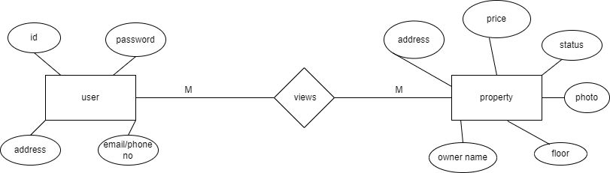
ER DIAGRAM

Slide 10
INPUT / OUTPUT FORM DESIGN

Slide 11

LOGIN PAGE

Slide 12
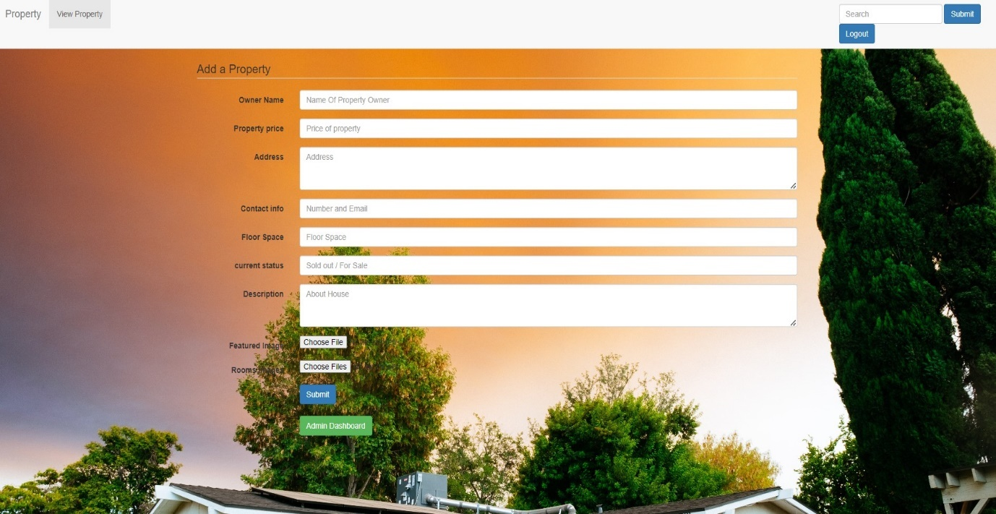
ADMIN HOME-PAGE

Slide 13
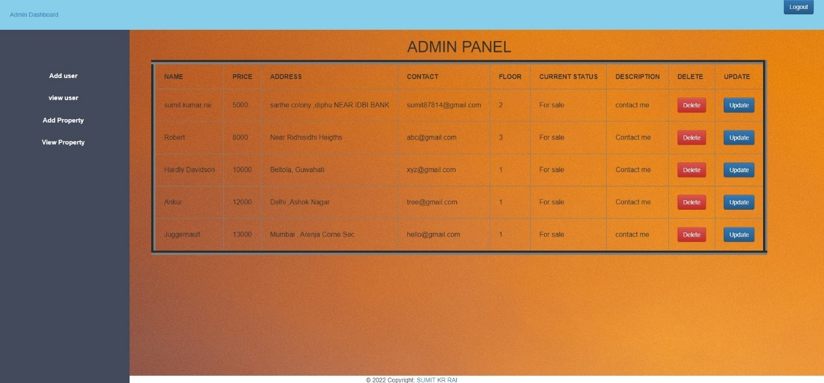
ADMIN DASHBOARD

Slide 14
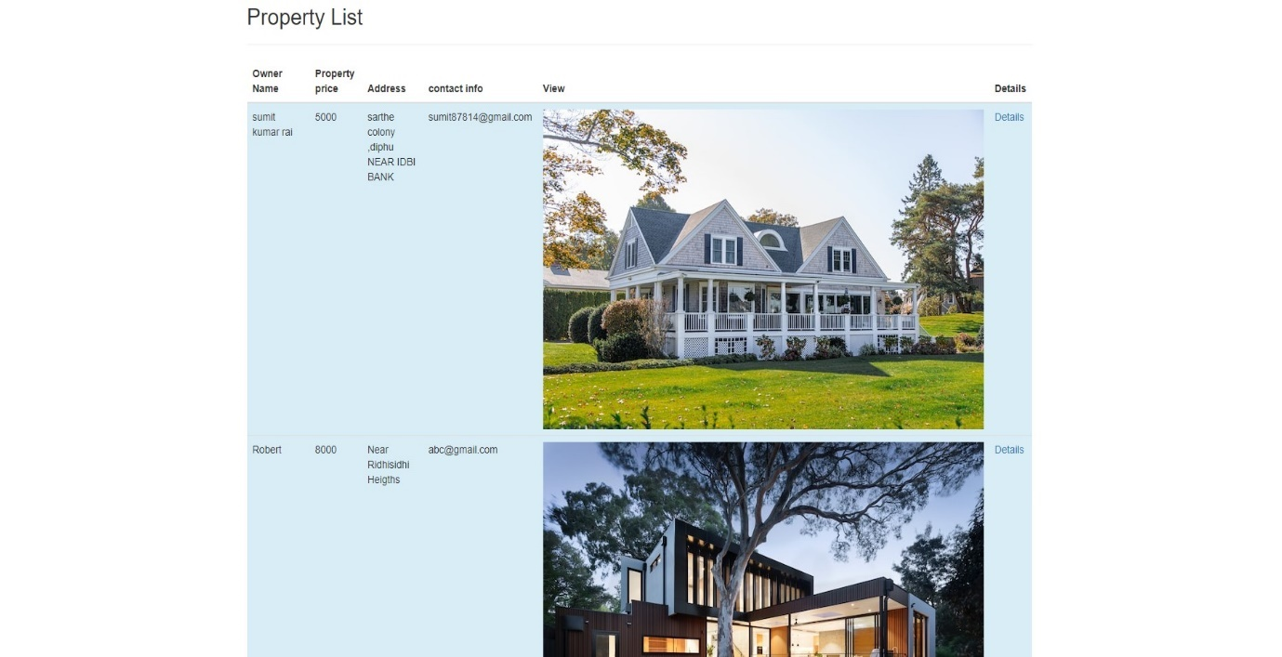
USER-HOME PAGE

Slide 15
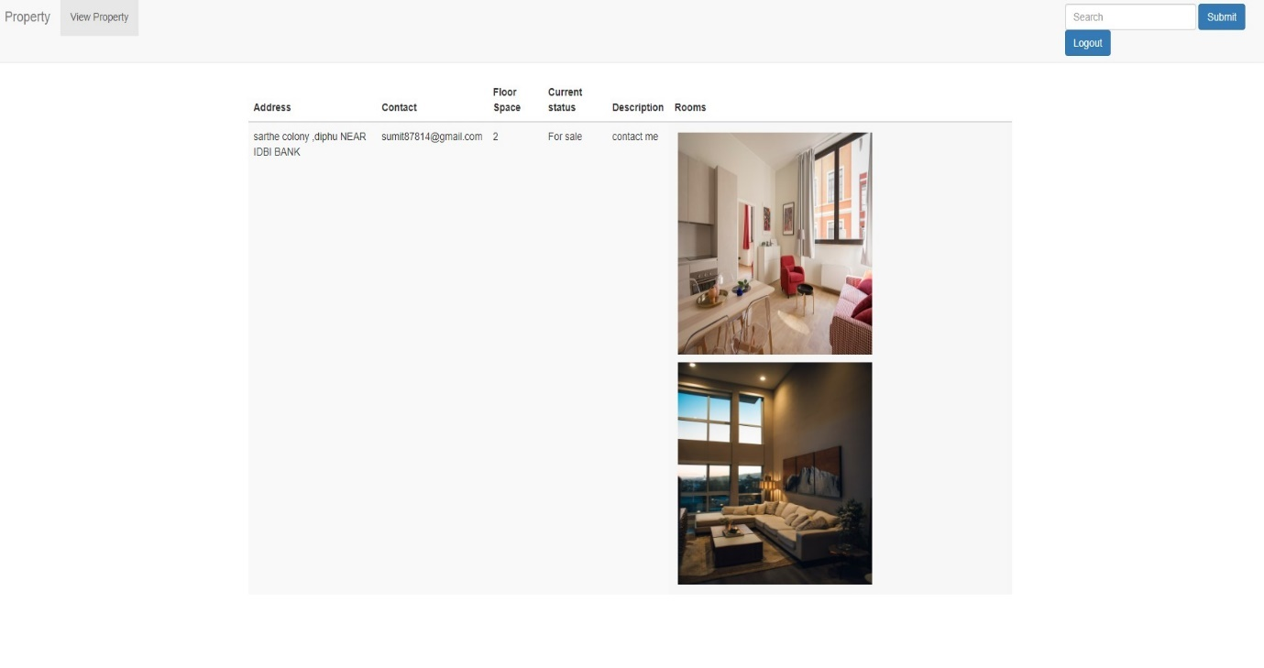

Slide 16
CONCLUSION
Working on this project was a good experience . It taught how important every step is in developing software, from collecting user requirements to planning and giving proper coding to every design.

Slide 17
THANK YOU
MADE BY- SUMIT KUMAR RAI
sumit87814@gmail.com

